Slide 1

CISC 250 – Business Telecomm Networks
ICMP
&
Lab 2

Slide 2
IP Packet
Bit 0
Bit 31
Version
(4 bits)
Header
Length
(4 bits)
Diff-Serv
(8 bits)
Total Length
(16 bits)
Identification (16 bits)
Flags
Fragment Offset (13 bits)
Time to Live
(8 bits)
Protocol (8 bits)
1=ICMP, 6=TCP,
17=UDP
Header Checksum (16 bits)
Source IP Address (32 bits)
Destination IP Address (32 bits)
Options (if any)
Padding
Data Field

Slide 3
ICMP: Internet Control Message Protocol
ICMP’s most common uses are testing and troubleshooting
Two of the most well-known utilities, PING and TRACEROUTE, rely on ICMP to perform connectivity tests and path discovery

Slide 4
ICMP: Internet Control Message Protocol
Used by hosts & routers to communicate network-level information
echo request/reply (used by ping)
error reporting: unreachable host, network, port, protocol
Network-layer, but “above” IP
ICMP msgs carried in IP packets

Slide 5
ICMP (cont’d)
ICMP message: type, code, checksum, & data (e.g. the first 8 bytes of IP datagram causing error)
Type Code description
0 0 echo reply (ping)
3 0 dest. network unreachable
3 1 dest host unreachable
3 2 dest protocol unreachable
3 3 dest port unreachable
3 6 dest network unknown
3 7 dest host unknown
4 0 source quench (congestion
control - not used)
8 0 echo request (ping)
9 0 route advertisement
10 0 router discovery
11 0 TTL expired
12 0 bad IP header

Slide 6
ping
Standard ping – used to check the availability of (connectivity to) a host
Ping <ip address>
If ping hostname, includes a rough check of DNS
Sends an ICMP ECHO_REQUEST (type = 8, code = 0)
Waits for an ICMP ECHO_REPLY (type = 0, code = 0)
Most pings can display round trip time
Most pings can allow setting size of packet
Can use to make a crude measurement of throughput

Slide 7
Lab 2 Part I

Slide 8
traceroute
Used to display routers used to get to a specified Internet Host
In Windows: tracert <ip address>
Source sends series of ICMP packets to destination
First has TTL =1
Second has TTL=2, etc.
As IP packets pass through each router, TTL in IP header is decremented
Packet is discarded when TTL decrements to 0

Slide 9
traceroute
When nth packet arrives to nth router:
Router discards datagram
And sends to source an ICMP TIME_EXCEEDED message (type 11, code 0), including name of router& IP address
When ICMP message arrives, source calculates RTT
Traceroute does this 3 times
When the packet eventually reaches destination
destination returns ICMP ECHO_REPLY (type = 0, code = 0)
source gets this ICMP, stops.

Slide 10
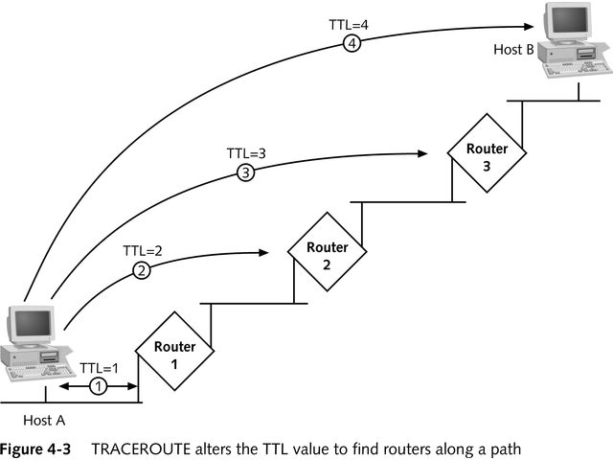
TRACEROUTE Alters the TTL Value to Find Routers Along a Path

Slide 11
Lab 2 Part II
Check IP address location
https://www.iplocation.net/
http://itools.com/tool/arin-whois-domain-search
http://itools.com/tool/ripe-whois-ip-address

